Slide 1
Note 14 Transaction Processing
CSC134
Dr. Haiquan Chen

Slide 2

ACID model
All the relational/SQL DBs (MySQL, SQL server, Oracle) are based on ACID model, i.e., must support the following four properties:
  Atomicity, Consistency, Isolation, and Durability
These properties are based on the concept of
Transaction

Slide 3
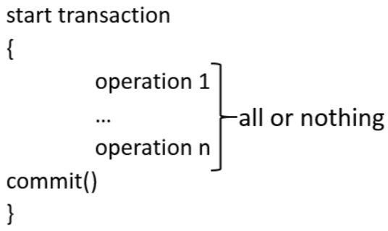
Transactions
A transaction is a group of operations treated as "a whole”.
  Each operation is either read or write operations (read – select, write - insert or update or delete).
    read (X): Reads a data item X into memory from disk.
    write (X): Writes the new value of data item X from memory to disk.

Slide 4
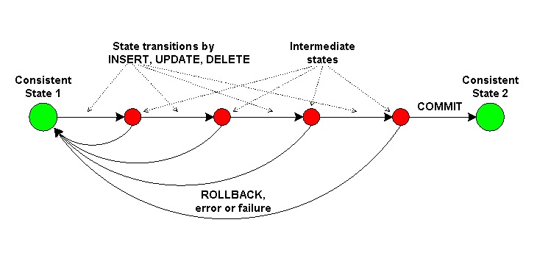
ACID model
  Atomicity: a transaction is either performed in its entirety or not performed at all.
  Only two results of running a transaction:
    All the operations in the transaction are completed successfully.
    (transaction committed)
    None of the operations in the transaction is completed (transaction aborted, i.e., rollbacked)

Slide 5
Atomicity
A transaction may fail:
Hardware issues (system crash)
Software issues
    integer overflow or division by zero.
    erroneous parameter values
    a logical programming error.

Slide 6
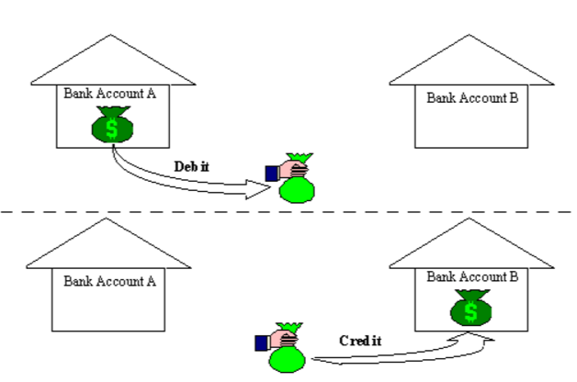
An example of Atomicity
You transfer money from one bank account to another. To do that you have to (1) withdraw the amount from the source account, and (2) then deposit it to the destination account.
All the operations have to succeed in full. Otherwise, if you stop halfway, the money will be lost.

Slide 7
An example of Atomicity
Three statements to use:
  START TRANSACTION or BEGIN start a new transaction.
  COMMIT commits the current transaction, making its changes permanent.
  ROLLBACK rolls back the current transaction, canceling its changes.
// sql script
BEGIN;
update Account set balance=balance-1000 where Account_Number = 5001 ;
update Account set balance=balance+1000 where Account_Number = 5002 ;
COMMIT;

Slide 8
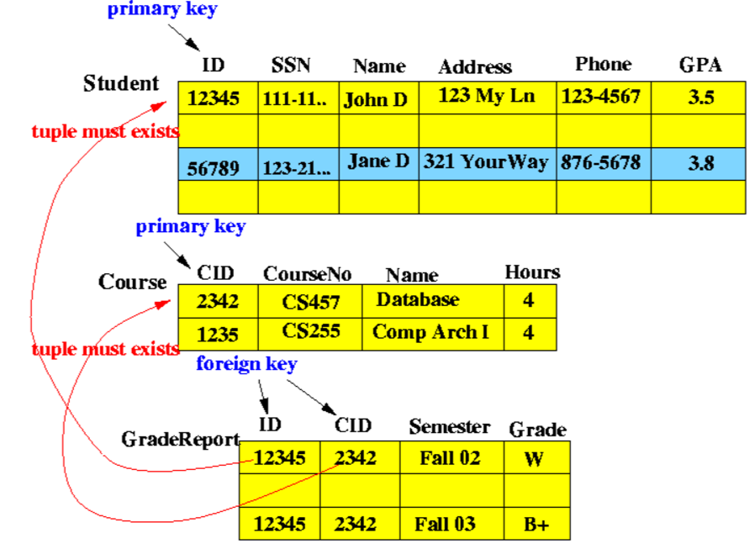
ACID model
  Consistency: A transaction must take the database from one consistent state to another.

Slide 9
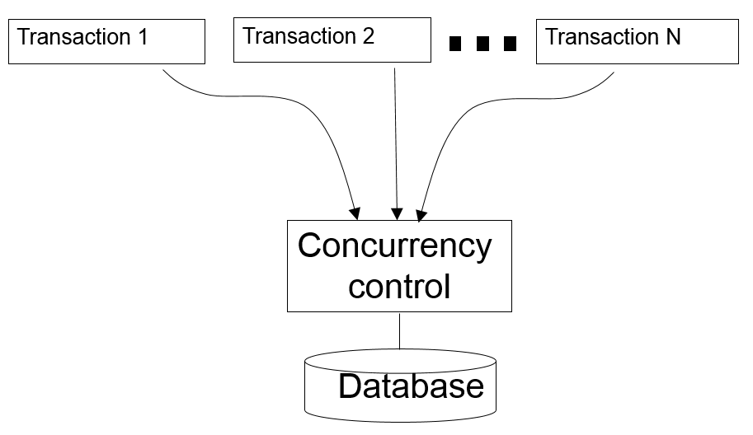
ACID model
  Isolation: A transaction should execute as if it was executed in isolation from other transactions, when many transactions execute concurrently.

Slide 10
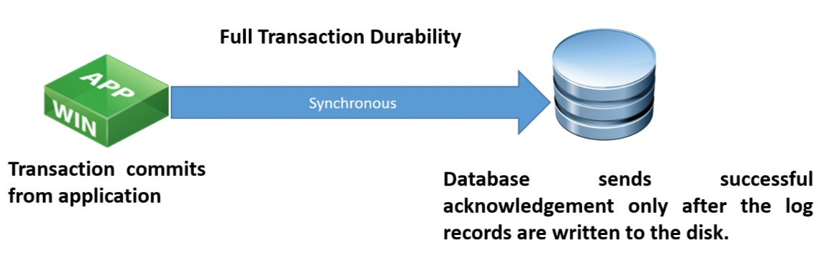
ACID model
  Durability: Once a transaction is completed, its result must be written to disk for permanent storage.

Slide 11
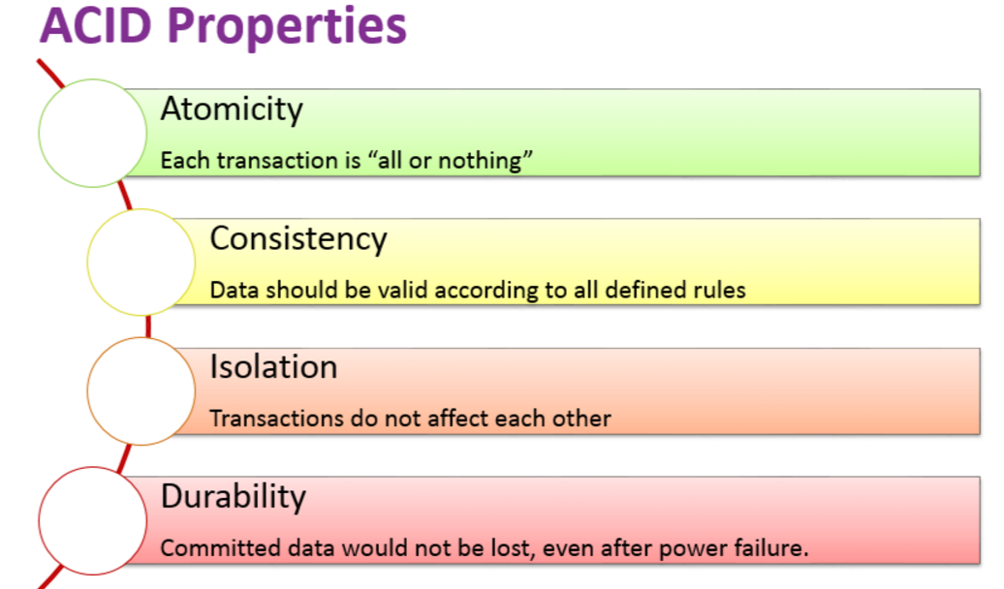
Takeaways

Slide 12
Hands-on using SQL
Video

